Slide 1
STAT 50 Section 4.4 Continued
03/11/2021

Slide 2













Slide 3










Slide 4




















Slide 5













Slide 6














Slide 7









Slide 8
















Slide 9
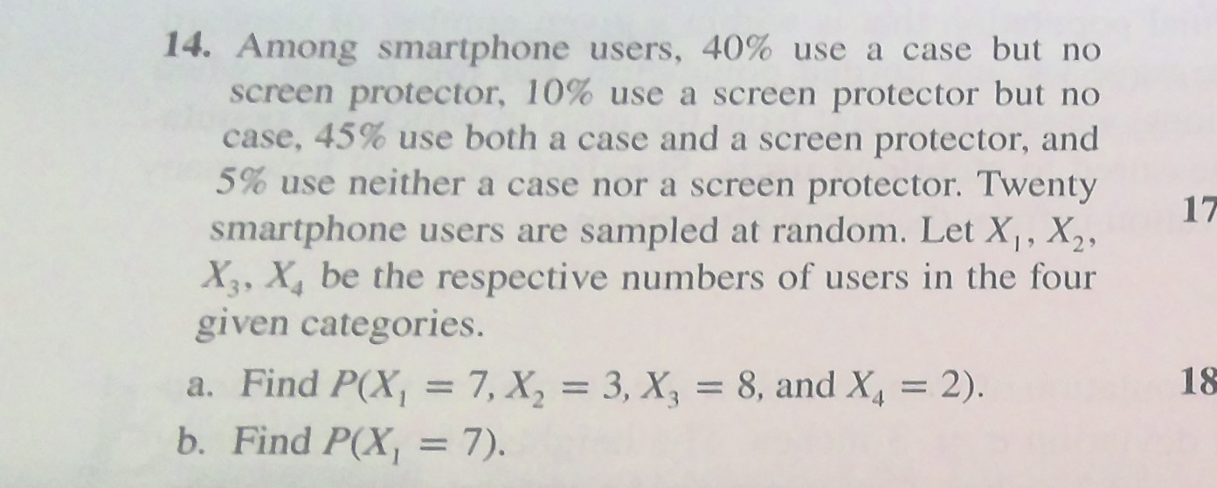


Slide 10










Slide 11





Slide 12



